Slide 1
DDC 6 New York Continuing Education Course

Slide 2
Agenda
Module/Topic | Est. Timing
Course Introduction | 5 min.
New York State Law Updates | 20 min.
Classroom Management | 15 min.
Classroom Safety | 40 min.
Choice Theory and Reality Therapy Refresher | 25 min.
Module/Topic | Est. Timing
Defensive Driving Foundations | 80 min.
Distracted Driving | 90 min.
Open Forum | 20 min.
NY Administrative Content | 20 min.
Course Summary | 5 min.

Slide 3
Course Requirements
This is a 6-hour course
You must complete the entire course to receive credit

Slide 4
Module 1: New York State Law Updates

Slide 5
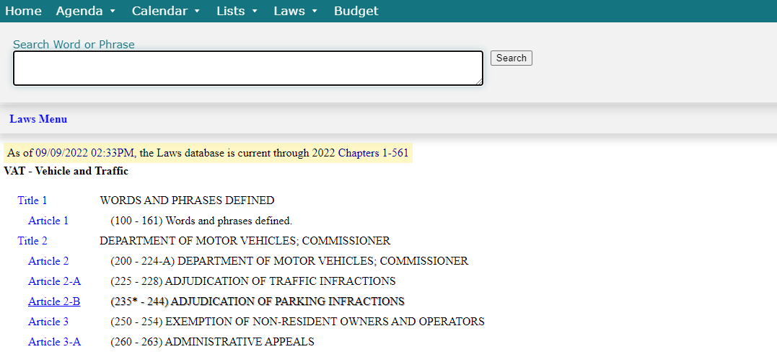
New York Vehicle and Traffic Laws
NYS Legislature site under “VAT”: http://public.leginfo.state.ny.us/lawssrch.cgi?NVLWO:

Slide 6
Driver’s License Suspension Reform Act
(Amd §§VAT Title 2 Article 2-A, 226, 227 & VAT Title 5 Article 20, 510, 514 & VAT Title 9 Article 45, 1802)
Took effect June 2021
Amended suspension of a driver’s license based on failure to pay a fine or failure to appear at certain traffic hearings
Limits the grounds for the suspension of a driver's license
Provides for additional notification when a person is required to make an appearance
Requires income-based payment plans to be available

Slide 7
Speed Limits In Certain Towns
(Amd §§VAT Title 8 Article 39 1643, 1662-a & 1622)
Took effect August 2022
Municipalities granted the authority to lower speed limits to help decrease fatalities and the severity of injuries from speed-related incidents
Former law stated the default max speed limit could not be lower than 30 mph
2018 research study showed reducing speed limits by 5 mph improved safety outcomes for motorists, pedestrians and bicyclists

Slide 8
Pre-Licensing Course Internet Pilot Program
(§ VAT Title 3 399-s. Article 12-D)
Took effect June 2020; will sunset June 2025
The commissioner shall conduct a pilot program designed to evaluate utilizing the internet for delivering an approved pre-licensing course
Qualified applicants may participate in the pilot program from June 13, 2020 to June 13, 2025
Class DJ and MJ licenses are not eligible to participate
Commissioner will report on the pre-licensing program and its results

Slide 9
Modified Muffler or Exhaust Systems
(Amd §§VAT Title 3 Article 9, 375.31 and 375.32; Amd §§Title 3 Article 9, 381.11 and 381.13)
Took effect April 2022
Amends subdivisions 31 and 32 of Vehicle Traffic Law § 375
It is illegal to manufacture, distribute, sell, or offer for sale a cut-out, bypass or similar device for the muffler or exhaust system of a motor vehicle. New fine for violation: $1,000 (previously $150)
Operating a motorcycle with altered exhaust systems is prohibited. New fine for violation: $500 (previously $150)

Slide 10
Modified Muffler or Exhaust Systems
(Amd §§VAT Title 5 Article 19, 501 (iv) and (vii) & 502)
Took effect August 2022
Modified “Class D” driver’s license (standard auto) and “Class M” driver’s license (motorcycle) to include operation of three-wheeled motor vehicle with two wheels in front and one in back (now classified as motor vehicle, not motorcycle)

Slide 11
Classroom Management

Slide 12
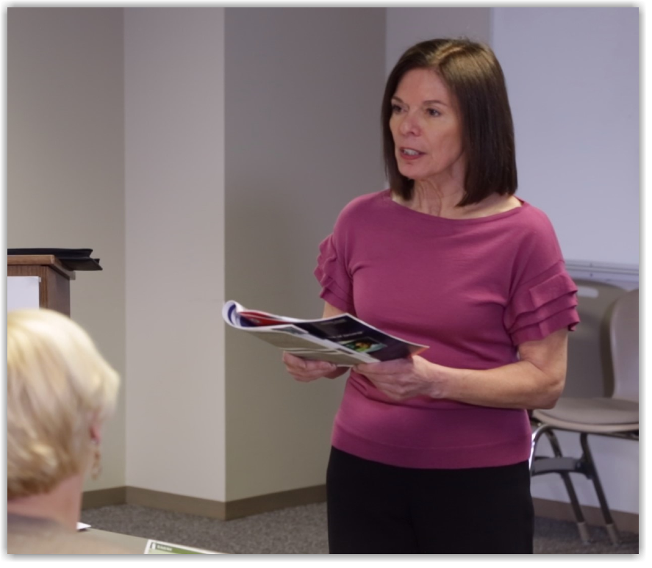
Instructor Responsibilities
Motivate participants
Address potentially disruptive behaviors
Keep participants focused and involved

Slide 13
Adult Learners
Need to be respected
Goal-oriented and practical
Need to know the relevance
Bring knowledge and unique life experiences
Have multiple responsibilities
Have established behaviors
Prefer hands-on applications
Tend to take mistakes personally

Slide 14
Adult Motivation Factors

Slide 15
Characteristics of Successful Instructors
Knowledgeable
Free of Bias
Clear Communicators
Enthusiastic about Defensive Driving
Confident
Empathetic

Slide 16
Communication Skills
Provide clear instructions or directions
Consider knowledge and expertise of participants
Choose words and body language carefully
Make smooth transitions
Maintain eye contact
Listen actively
Summarize information

Slide 17
Listen Actively
Be patient
Avoid quick answers
Know and control your biases
Avoid distractions
Postpone discussion if you are distracted
Be empathetic
Maintain eye contact

Slide 18
Maintain Eye Contact
Attracts and keeps participants’ attention
Puts you in touch with your participant
Helps you read non-verbal communication
Opens communication between the instructor and participants
Shows sincerity
Inspires participants’ confidence in the instructor

Slide 19
Other Non-Verbal Techniques
Stance
Head movement
Facial expressions
Hand gestures

Slide 20
Handling Participant Questions
Respect the questioner
Repeat the question
Integrate the question into discussion
Neutralize negative questions
It’s okay to say you don’t know an answer
Avoid long-winded answers
Ask if your answer was satisfactory
Announce at the beginning of the course how you will handle questions

Slide 21
Focus on Participant Needs
Make use of participants’ experience
Be sensitive to age and educational levels of group
Try to accommodate all learning styles (visual, auditory and kinesthetic)
Maintain your own enthusiasm
Be prepared for challenging participants
You are there to give participants what THEY need from the course!

Slide 22
Young Adult Learners
Want instructors who:
Are non-threatening and non-punitive
Do not condescend or judge
Help participants relax
Treat them with respect

Slide 23
Repeat Attendees
Acknowledge their experience with the class
Ask them how they applied concepts from the course
Ask them to help other participants, where appropriate
Identify content/topics that are new to them or engage them

Slide 24
Working With Disabled Participants
Set up accommodations
Frequently check in
Ask other participants to help, where appropriate
Provide remediation

Slide 25
Keys to Classroom Management
Work to connect with and motivate participants
Recognize participants’ knowledge and experience
Use effective verbal and non-verbal communication techniques
Treat participants with respect

Slide 26
Classroom Safety

Slide 27
COVID-19 Safety

Slide 28
Pandemic Response in the Classroom
To address the continuing threat of the COVID-19 pandemic, NSC adheres to guidelines and recommendations set forth by the Centers for Disease Control (CDC) and the New York State Department of Health.
The National Safety Council’s stance on COVID-19 vaccination: COVID-19 vaccines are the clearest route to ensuring worker safety and well-being is prioritized in the workplace. Increased vaccine uptake is essential to stop the spread of COVID-19.

Slide 29
CDC Guidelines: COVID-19
Recommendations for fully-vaccinated people
Wear a mask in public indoor settings if in an area of substantial or high transmission.
Get tested if experiencing COVID-19 symptoms or if you came into close contact with someone with COVID-19.
Isolate if you test positive for COVID-19 or are experiencing symptoms.
Follow any applicable federal, state, local, tribal, or territorial laws, rules, and regulations.

Slide 30
CDC Guidelines: COVID-19
Recommendations for non-vaccinated people
Authorized COVID-19 vaccines can help protect you from COVID-19.
You should get a COVID-19 vaccine as soon as you can.
Wear a mask in indoor public spaces.
Stay 6 feet away from others.
Avoid crowds and poorly ventilated spaces.
Wash your hands often.
Cover coughs and sneezes.
Clean and disinfect. Clean high touch surfaces daily.

Slide 31
NYS Department of Health Guidelines: COVID-19
Check the Department of Health Guidelines before class: https://coronavirus.health.ny.gov/home
COVID-19 Guidelines as of publishing date:
All New Yorkers 6 months and older should get vaccinated and get their booster when eligible
If you are experiencing symptoms or were exposed, get tested
If you test positive, stay home and talk to your healthcare provider about treatment
Masks are still required in healthcare facilities. Masks are optional in correctional facilities, homeless shelters, airports and on public transit.

Slide 32
Key NSC Facility Recommendations
Schedule full sanitization of facility and equipment prior to instructors and students returning to the classroom
Install hand sanitizer stations or provide hand sanitizer bottles at entrances, bathrooms, classrooms and other common areas.
Discourage use of shared objects, such as pens, equipment and supplies.
Develop site cleaning guides; assure proper disinfecting techniques
Establish protocol for proper disposal of face masks, gloves and other PPE

Slide 33
Key NSC Facility Recommendations
Set up the classroom to allow for a minimum of 100 square feet for the instructor presentation area and 36 square feet for each student.
Encourage physical distancing through visual cues, such as floor markings and signage.
Document and display appropriate occupancy for rooms to allow for proper physical distancing.
Restrict common area and bathroom capacity to maintain physical distancing.
Provide a supply of general surgical masks to provide to all students and instructors.

Slide 34
Student Communication
Notify students to stay at home if experiencing any COVID-19 symptoms.
Notify students in advance of class expectations for PPE (mask wearing), physical distancing, temperature checks prior to entry, etc.
Tell students they can bring their own face covering/mask or one will be provided to them.

Slide 35
Student Communication (continued)
Indicate that hand sanitizer will be required upon entry.
Encourage students to use disinfecting wipes; assure students of safe, disinfected classrooms and equipment prior to arrival.
Notify students that no food or drink will be provided. Students may bring their own, but should not share with others.

Slide 36
Proof of Vaccination or Negative Test
If your facility requires proof of vaccination or proof of a negative COVID-19 test, notify students of this requirement prior to class.
If students are not vaccinated, you may require proof of a negative COVID-19 test instead. For this, we recommend following CDC guidelines for travel: students will need to get a viral test no more than 3 days prior to class and show their negative results before entering the training facility.

Slide 37
NSC Instructor Recommendations: COVID-19
Get fully vaccinated
Wear a mask UNLESS you are (1) fully vaccinated AND (2) located at a podium away from participants
Maintain proper physical distancing
Disinfect the presentation area and workspace
Maintain proper hand hygiene

Slide 38
Maintaining a Safe Classroom

Slide 39
Overall Principles for a Safe Classroom
Secure your classroom, keeping it free of potential weapons and negative behaviors.
Address inappropriate behavior early.
Foster an environment of respect with consistent enforcement of policy without exerting authority.
Establish constant awareness about potential safety threats.
SAFE

Slide 40
Instructor Must-Haves
Calm, respectful demeanor
Firm yet fair
Engaged listener
Exhibits two-way communication
Builds rapport with students
Demonstrates empathy

Slide 41
Be Prepared and Stay Aware
Review the classroom/facility layout
Familiarize yourself with local resources
Be aware of exit points and support resources
Keep aware of hostile, mentally impaired or potentially dangerous students
Be aware of your own mood and response to hostility

Slide 42
Establishing a Safe Classroom
Prior to class:
Arrive a little early to familiarize yourself with the location and layout
Look for exit locations
Locate the front desk and security services
Introduce yourself to facility staff and build rapport
Before class begins, introduce yourself to students and work to build rapport

Slide 43
Choose Safe Locations for 1:1s
If you need to discuss a situation with a student, choose a location in the classroom that is as private as possible but where you are still able to:
Leave easily and not be blocked in
Summon support if needed
Maintain confidentially, while ensuring you are not totally isolated

Slide 44
NSC Code of Conduct

Slide 45
Setting Clear Guidelines
Establish the classroom code of conduct at the beginning of class and stick to it.
You will establish your authority
You provide students with parameters of what is acceptable behavior
Sticking to the guidelines builds your credibility and rapport
You have clear expectations to point to if a student is uncooperative

Slide 46
Most Common Rule Violation Discussions
Showing up late to class or after break
Talking, texting or otherwise on their phone in class
Sleeping in class
Using threatening, vulgar language or disruptive behavior

Slide 47
The “Nevers” for Instructors
Avoid touching a student, regardless of how harmless you think it may be
Never belittle a student no matter how angry they may make you
Never allow a violent or highly disruptive student to stay in class
Focus on behavior, NOT the student

Slide 48
Characteristics of an Angry Person
A disruptive, obnoxious student
Uses profanity or curses
Yells, uses a loud voice
Talks back to instructor
Disrupts the classroom
Challenges instructions or learning points
Overtly hostile
May be a way of releasing hostility
Seething, silent rage, embittered student
Sits quietly and does not engage in class discussion
Hostile stare
Rigid posture
Intense “presence”
Potentially, the more dangerous of the two

Slide 49
The Instructor’s Best Defense
Stay calm
Do not allow students to upset or control you
Be aware of your attitude and emotional state
Know your hot buttons

Slide 50
Keys to De-escalating Hostile Behavior
Non-verbal messages
Body Language
Speaking tone and inflection
Active listening
Maintaining personal space
Supportive stance
Setting limits

Slide 51
Non-Verbal Messaging
Avoid body language mishaps:
Crossing your arms
Hands on your hips
Rolling eyes
Staring or glaring
Checking your watch
Hands behind your back

Slide 52
Speaking Tone and Inflection
Use the appropriate speaking tone and inflection (generally, calm and neutral).
Avoid:
Making the pitch of your voice too high or too low
Using a tone of voice that is too soft or too loud
Speaking at a rate that is too slow or too fast
Using inappropriate inflection of voice in different situations

Slide 53
Active Listening to De-escalate Behavior
Focus on what the person is saying
Confirm understanding: repeat what the person told you without parroting
Do not make value judgments: just listen
Establish trust and rapport
Do not interrupt: let the person talk
Do not think about a response until they are finished talking

Slide 54
Maintain Personal Space
Maintain your personal space and their personal space
Most people’s personal space is at least an arm length away or further for safety
Getting into the personal space of someone who is agitated can escalate a situation
Maintaining your personal space can protect you from getting hit if the situation turns physical

Slide 55
Use a Supportive Stance
It is a non-threatening and non-challenging stance
It gives a perceived escape route for the student
It gives you an escape route
It gives you more balance if someone takes a swing or punch at you
It communicates respect by honoring their personal space
It gives you your personal space

Slide 56
Setting Limits
Redirect the thoughts of students back to their behavior
Create a situation for which a decision or action by them is needed
Setting a limit is not the same as issuing an ultimatum
The purpose of limits is to teach not to punish
Setting limits is more about listening than teaching
By listening you will learn more about what is important to the student that will help you to set more meaningful limits

Slide 57
5 Steps to Set Limits
Explain which behavior is inappropriate
Explain why the behavior is inappropriate
Give reasonable choices with consequences
Allow time for the student to accept limits
Be prepared to enforce consequences

Slide 58
Instructor Dos and Don’ts
Do:
Stay calm
Isolate the situation
Set appropriate limits
Listen and watch
Pay attention to body language
Give space and time
Be consistent
Have a plan
Don’t:
Overreact
Give false promises
Get into a power struggle
Blame or be judgmental
Threaten
Fake attention
Use jargon

Slide 59
AVOID Putting Your Hands on a Student!
In hostile and intense confrontations, aggressors will often invade your space or put their hands in your face.
Do everything you can not to touch them. Of course, you can defend yourself if they strike.
Keep backing up and avoid contact.

Slide 60
Common Sense
If experiencing an actual crisis or if there is an imminent threat of violence:
GET AWAY
Call law enforcement
Report concerns

Slide 61
Intoxicated and Mental Health Concerns
It is very difficult to defuse someone who is not able to be rational or who is incoherent
The best solution is to remove them from the classroom and report concerns
Report concerns to law enforcement. It is important to remember that we still must ensure everyone’s safety

Slide 62
Fights Between Students
Stop disruptive, inappropriate behavior at early stages
DO NOT physically intervene: breaking up fights is very dangerous
Depending on the circumstance: leave, call police, clear out other students

Slide 63
#1 Reason to Report
For your safety and the safety of your co-workers and students

Slide 64
Case Study
Two students arrive to the classroom in the morning on time. When the instructor is registering the students for the class one student smells of marijuana. The other student smells like alcohol and he is carrying a brown bag containing some sort of drink.
What action should the instructor take with the two students?

Slide 65
Best Practices
Follow the rules and regulations of the Delivery Agency as you register drivers
Talk with each of the students independently
Use your judgment
Let the students explain the situation
If the students are combative and confrontational, tell them that they need to reschedule

Slide 66
Guiding Principles
Safety First
Listen to your gut. If you feel you are in danger, keep physical distance
Do not get cornered or alone with an offender. Never go outside the room with a student
Scan for hidden weapons
Everything is easier when handled the right way from the start

Slide 67
Guiding Principles
A common mistake is to try to get the class to “like you” by being too lenient with the rules
You must be consistent with following all of the rules and the code of conduct for students
You must enforce the code of conduct with all students consistently

Slide 68
Guiding Principles
Many offenders only become violent after they feel they are entitled to it. Make sure rules are enforced at the very beginning
Do not come up with an inappropriate rule or reactionary rule out of frustration
Students will behave differently when others are watching. Try to find a private place in the room to talk with the student

Slide 69
Guiding Principles
Finally, don’t forget to follow your gut. Every incident is unique with many variables
If you feel unsafe, take action to improve safety immediately
If you feel that you can work with the student to maintain discipline and complete the course, the effort can be worthwhile

Slide 70
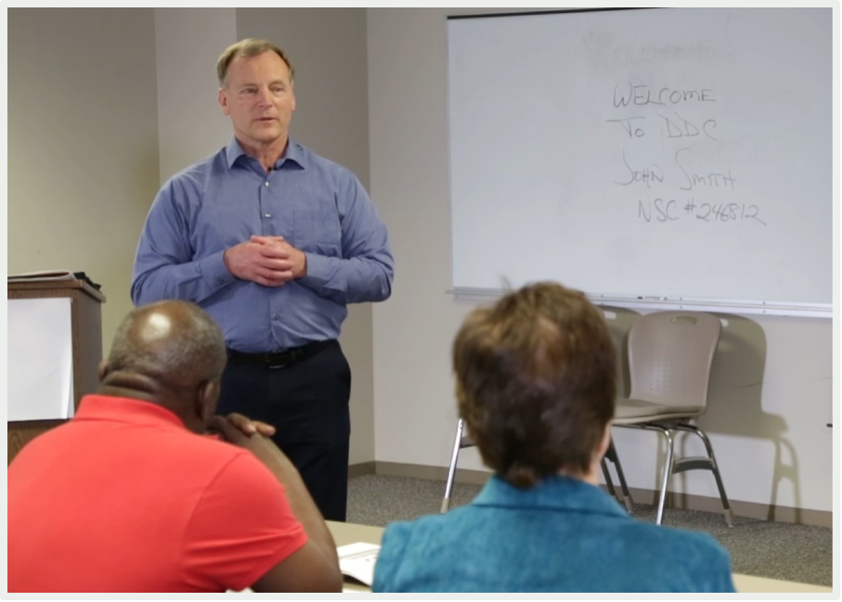
The Most Powerful Prevention Measure
Creating a positive, healthy classroom

Slide 71
Refresher: Choice Theory & Reality Therapy

Slide 72
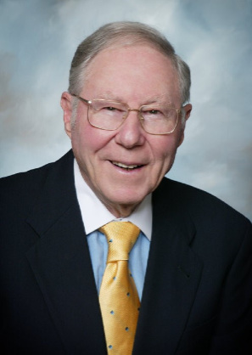
Dr. William Glasser
Medical degree from Case Western
Psychiatric training at a Veterans Administration Center and UCLA
Published over 20 books, including “Reality Therapy” and “Choice Theory”
Founded the Institute for Reality Therapy, which evolved into the William Glasser Institute

Slide 73
The Five Basic Needs
“We are all driven by five genetic needs. All behavior is an attempt to fulfill one or more of these basic needs.”
Survival (Self-Preservation/Safety/Security)
Love and Belonging (Acceptance)
Fun (Joy/Enjoyment/Relaxation)
Freedom (Independence)
Power (Significance/Recognition)

Slide 74
Needs vs. Wants
Needs
Genetic
General
Universal
Common
Constant
Wants
Non-genetic
Very specific
Particular
Uncommon
Changing

Slide 75
Fulfilling Our Basic Needs
We are the only ones who can decide when our needs are satisfied
If we attempt to fulfill someone else’s needs, we set ourselves up for failure

Slide 76
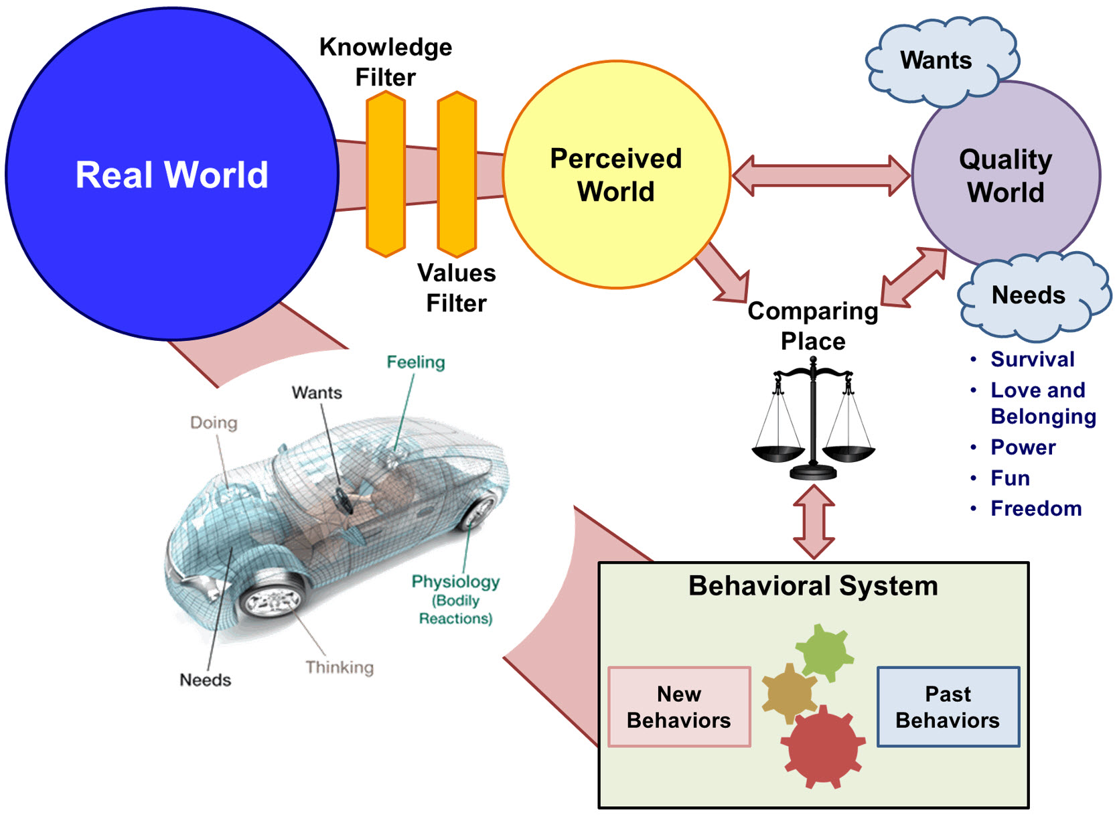

Slide 77
The Real World
It is what it is, whether we like it or not
We decide how many experiences we have in the real world
“The real world is energy. We turn it into information.”

Slide 78
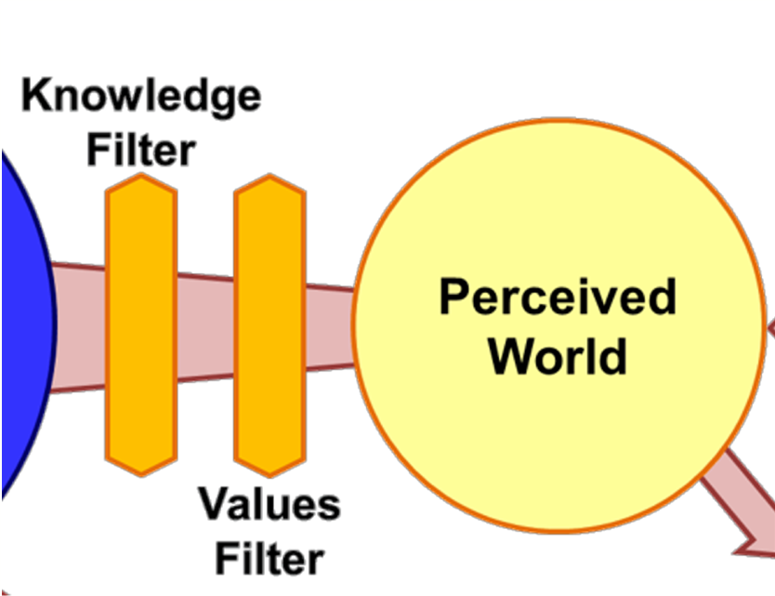
The Perceived World and Our Filters
Perceived world is limited by our senses
Our interpretation of the world may not be the same as others’
How we perceive the world is influenced by our senses and our unique filters: the Knowledge Filter and the Values Filter

Slide 79
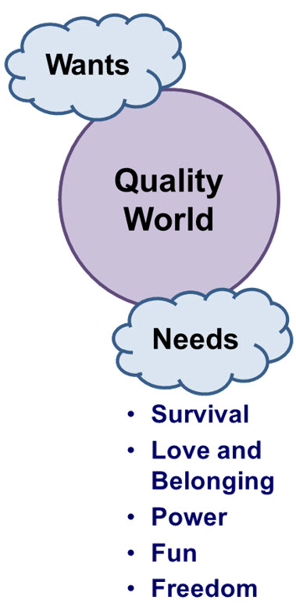
Our Quality World
Our Quality Worlds are personal
They are made up of pictures of our needs and wants
Our Quality Worlds consist of:
People
Things
Ideas and Beliefs

Slide 80
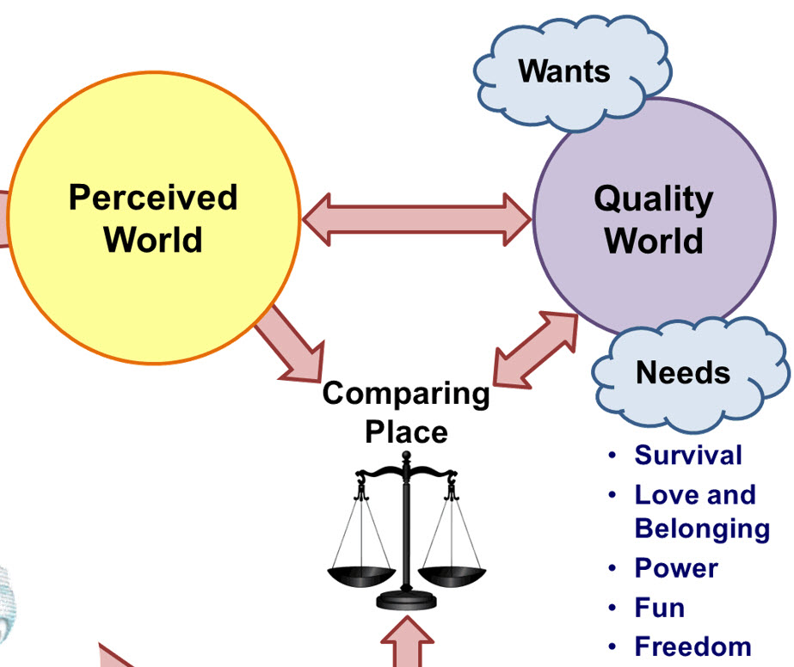
The Comparing Place
Perceptions go to the Comparing Place for analysis
“This is what I’m getting. Is it what I wanted?”
The perception is weighed against a picture from the individual’s “wants” in the Quality World

Slide 81
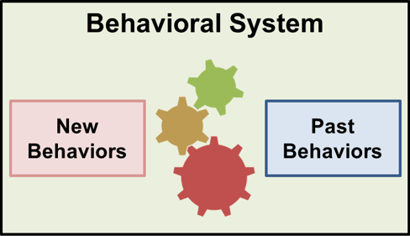
The Behavioral System
Storage file of actions you have taken in the past to get what you want
If you can’t find a behavior that you believe will work, then you create a new behavior

Slide 82
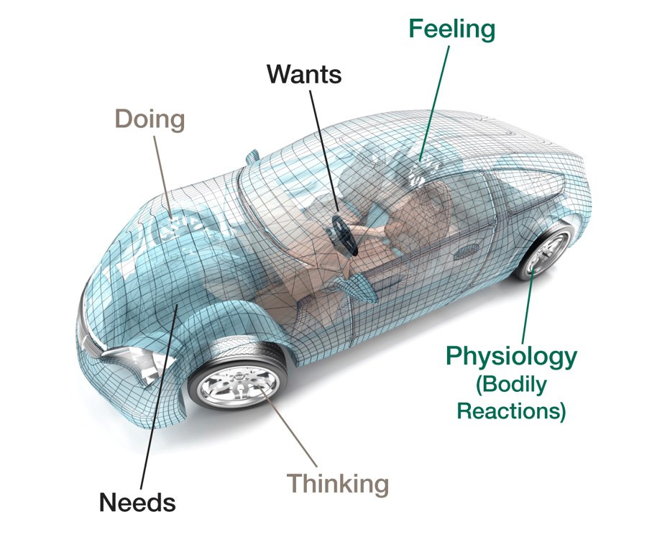
The Behavioral Car

Slide 83
Behavior Choices
All total behavior is chosen
We always have control of our behavior
All choices have consequences

Slide 84
Changing Behavior
“All we can give or get from other people is information.”

Slide 85
Reality Therapy: The Psychology of Choice Theory

Slide 86
Principles of Choice Theory
YOU are responsible for what you do, no one else
People can change and live more effective lives
All choices are effective, short-term or ineffective
Responsible and respectful choices are most often effective

Slide 87
The Psychology of Choice Theory: Five Questions
What do you want?
Is what you are doing helping you get what you want?
What would you have to do differently to get what you want?
What are you willing to do to get what you want?
When would the consequences get so painful that you would be willing to change?

Slide 88
The Psychology of Choice Theory: Five Questions
What do you want?
Is what you are doing helping you get what you want?
What would you have to do differently to get what you want?
What are you willing to do to get what you want?
When would the consequences get so painful that you would be willing to change?

Slide 89
The Psychology of Choice Theory: Five Questions
What do you want?
Is what you are doing helping you get what you want?
What would you have to do differently to get what you want?
What are you willing to do to get what you want?
When would the consequences get so painful that you would be willing to change?

Slide 90
The Psychology of Choice Theory: Five Questions
What do you want?
Is what you are doing helping you get what you want?
What would you have to do differently to get what you want?
What are you willing to do to get what you want?
When would the consequences get so painful that you would be willing to change?

Slide 91
The Psychology of Choice Theory: Five Questions
What do you want?
Is what you are doing helping you get what you want?
What would you have to do differently to get what you want?
What are you willing to do to get what you want?
When would the consequences get so painful that you would be willing to change?

Slide 92
The Psychology of Choice Theory: Five Questions
What do you want?
Is what you are doing helping you get what you want?
What would you have to do differently to get what you want?
What are you willing to do to get what you want?
When would the consequences get so painful that you would be willing to change?

Slide 93
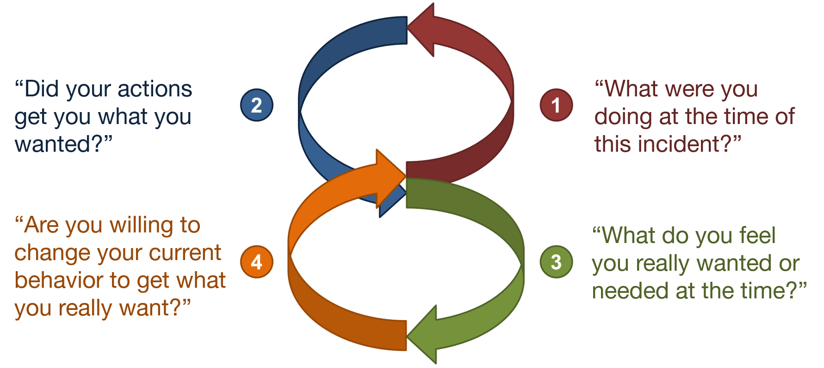
“Lazy Eight”
“What will it take for you to change?”

Slide 94
Changing Behavior
A person will not change until they decide that what they are doing is not working.

Slide 95
Application in the Classroom

Slide 96
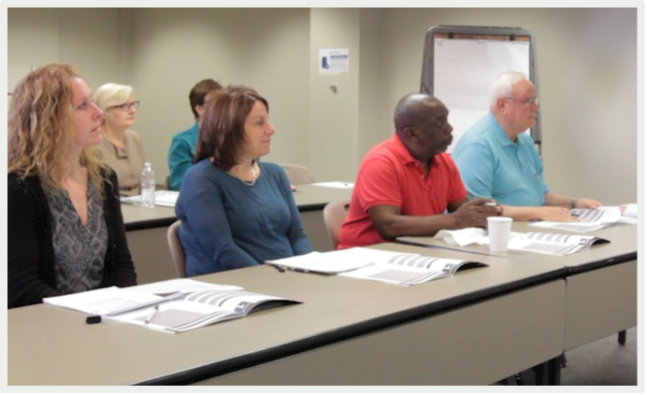
Applying Choice Theory When Instructing NSC Courses
We cannot force others to do anything
People are responsible for their choices
Energy expended to change another rarely works and most often leads to frustration
It is completely the choice of the person to choose or not to choose to change their behavior

Slide 97
Choice Theory in the Classroom
Create a trusting relationship
Help participants evaluate their behavior
Assist participants in creating a plan and/or choosing alternative behaviors

Slide 98
Choice Theory in the Classroom
Look for opportunities to help participants:
identify their current behavior choices
identify alternative behavior choices
make a plan for change
The information we provide can help make our roads safer for everyone.

Slide 99
Defensive Driving Foundations
New Drivers
Mature Drivers
Vehicle and Driver Control
Stopping and Following Distance

Slide 100
New Drivers

Slide 101
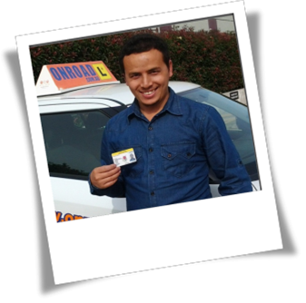
New Drivers
May not know what hazards to watch for
May not be able to determine proper stopping distance

Slide 102
Question
What should be the minimum safe following distance for new drivers?
2 seconds
4 seconds
6 seconds

Slide 103
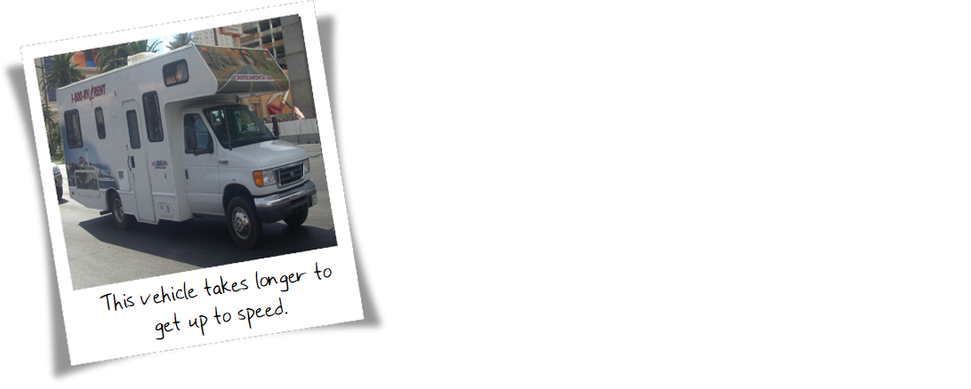
Vehicle Size

Slide 104
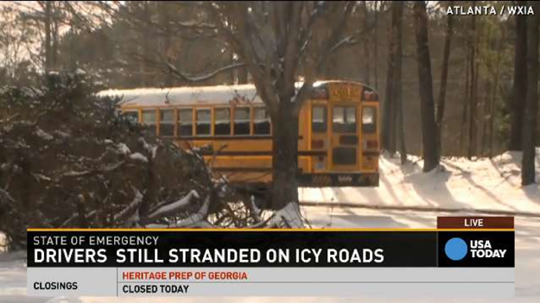
Weather Conditions

Slide 105
Plan for the Drive

Slide 106
Graduated Driver’s License/ Junior Operator’s License
Reduces high crash risk by 20-40%
Reduces exposure to high crash risk situations
Builds experience and skills in lower-risk conditions

Slide 107
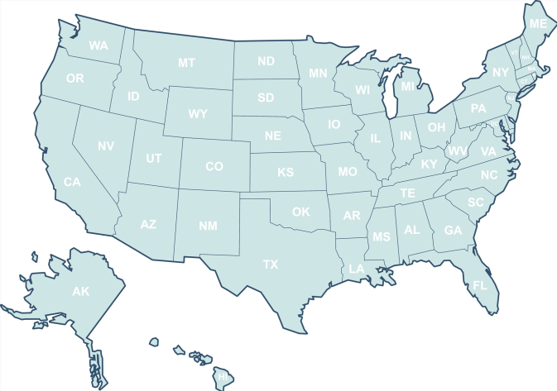
GDL/JOL Varies by State
Highlights of New York State Laws
Learner’s Permit Rules:
All drivers and passengers must use safety restraints
Supervising drivers must be 21 or older with a valid license
No more than 1 passenger under age 21 who is not a family member
No passengers allowed in the front seat other than the supervising driver
Junior Driver License Restrictions:
All drivers and passengers must use seat belts
Restricted driving times and specific regulations based on region (e.g., NYC, Long Island, Upstate New York)

Slide 108
3-Stage GDL/JOL System
Learner’s Permit
Intermediate (Junior) License
Full License

Slide 109
Parents Play a Key Role
Parents play a key role in the success of the GDL/JOL System

Slide 110
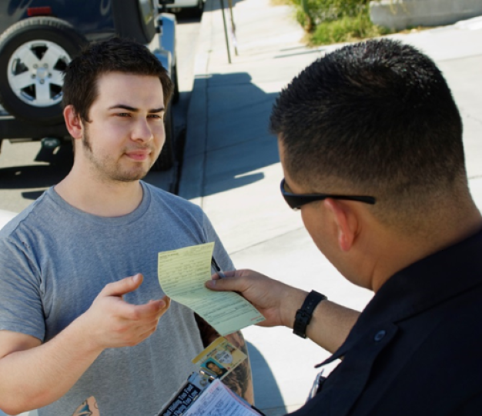
Law Enforcement Plays a Key Role
Law Enforcement Officers play a key role in the success of the GDL/JOL System

Slide 111
High Crash Risk Situations
Night driving or low light situations (restricted driving time from 9 pm- 5 am)
Passengers
Technology

Slide 112
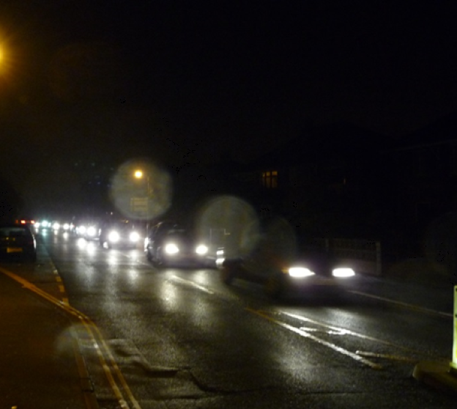
Night Driving
Fatal car crashes are three times as likely at night

Slide 113
Night Driving
Inexperience
Lower visibility
Distractions
Fatigue
Alcohol/Drug Use

Slide 114
Passengers
Motor vehicle collisions are the number 1 cause of teenage death
17% of teen driver fatal collisions happen between 9:00 p.m. and midnight

Slide 115
Passenger Restrictions Reduce Crashes

Slide 116
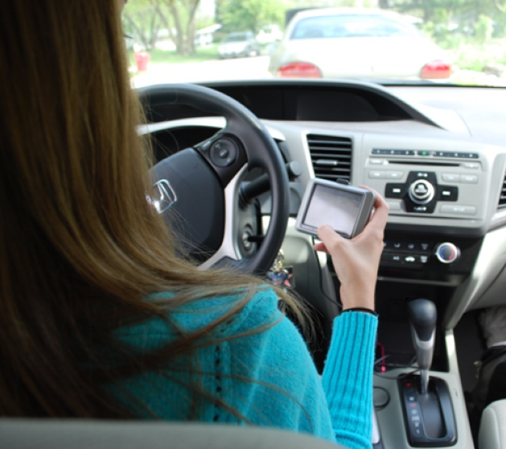
Technology
1.3 million crashes a year can be attributed to using cell phones

Slide 117
Key Points
When inexperience meets the road, crash risks increase
GDL and JOL systems are proven to reduce teen crashes by as much as 40 percent
GDL/JOL systems maximize driving experience and minimize common crash risks

Slide 118
Mature Drivers

Slide 119
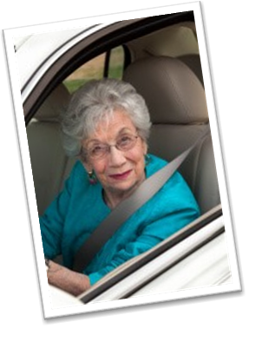
Mature Drivers
Dignity
Self-respect
Autonomy

Slide 120
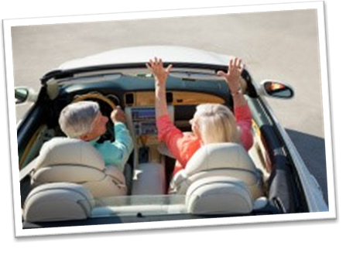
Mature Drivers
Mature Drivers are more likely to be in a two-vehicle collision

Slide 121
Mature Driver Facts
Night driving is the most dangerous
Highest fatal crash rate on rural, non-interstate two-lane roads
Mature drivers crashes are more likely to be multi-vehicle collisions
Mature drivers self-regulate driving

Slide 122
The Effects of Aging
Driving is based 90% on visual cues

Slide 123
Mature Driver Safety Tips
Have eyes tested
Clear windshield
Clean headlights
Avoid glare
Avoid left lane
Reduce distractions
Communicate
Drive smart
Listen

Slide 124
Vehicle and Driver Control

Slide 125
Vehicle Safety Features
Safety equipment is no substitute for defensive driving techniques

Slide 126
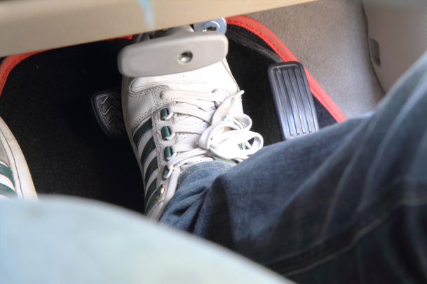
Anti-Locking Brakes (ABS)
When the drivers inappropriately “pump” anti-locking brakes, problems occur

Slide 127
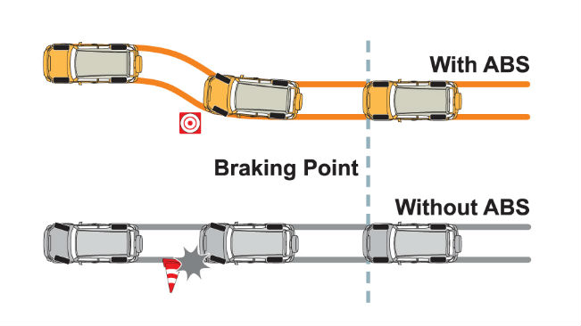
Anti-Locking Brakes (ABS)

Slide 128
Anti-Locking Brakes (ABS)
Use the safest following distance as dictated by the driving conditions

Slide 129
Tires

Slide 130
Tires: Tread Depth
If you have less than 2/32 inch of tread depth you must replace the tire

Slide 131
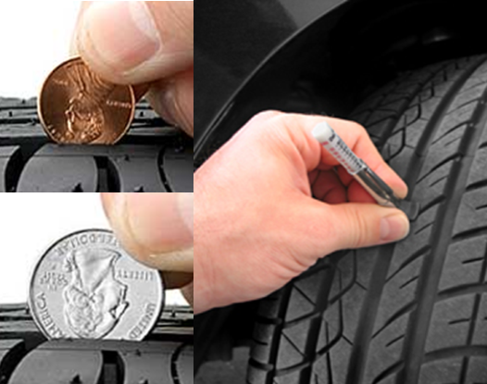
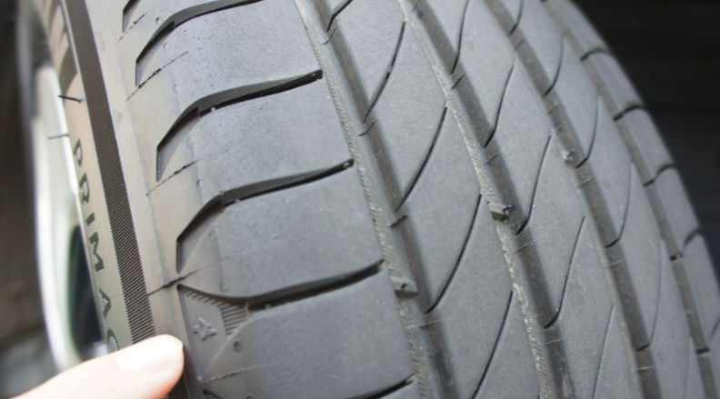
Tires: Tread Depth
When driving in rain, you need 4/32 of an inch (3.22 mm) of tread depth
Use a penny for 4/32 tires
Check tread depth indicators on tires themselves

Slide 132
Tires: Tread Depth
When driving in snow, you need 6/32 of an inch (4.88 mm) of tread depth
Use a quarter for 6/32 tires
Check tread depth indicators on tires themselves

Slide 133
Vehicle Weight and Distribution

Slide 134
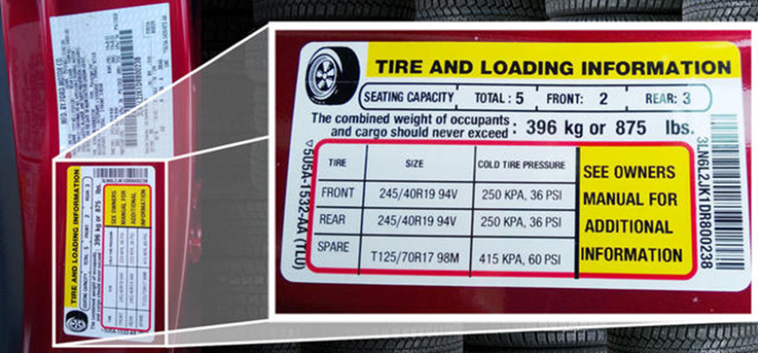
Tire Inflation
Air tires to the limit in the owner’s manual or on the stickers

Slide 135
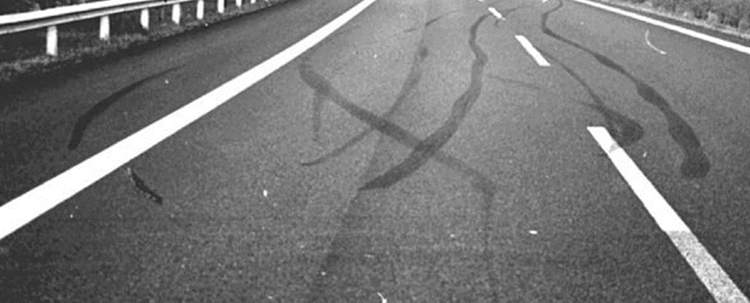
Recover from Skidding
Turn the wheel in the direction you want the front of the vehicle to go

Slide 136
Mirrors: Inside Rearview Mirror
See out the rear window and as far back up the road as possible

Slide 137
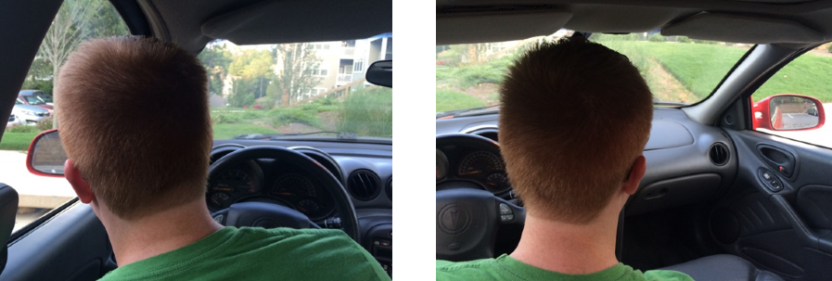
Mirrors: Side Mirrors
Rest your head against the driver’s side window

Slide 138
Blind Spots

Slide 139
Speeding
Excessive speed or a speed too fast for conditions

Slide 140
Speeding
Excessive speed increases reaction and perception distance
Excessive speed increases stopping distance
Excessive speed compromises vehicle safety
Higher speeds reduce a driver’s field of vision

Slide 141
Safe vs. Legal
Good judgment is paramount to defensive driving

Slide 142
Scanning Patterns

Slide 143
Avoiding Head-on Collisions
A head-on collision is the most fatal type of traffic incident
Remember the Four Rs

Slide 144
The Four Rs (plus one)
READ the road ahead
Drive to the RIGHT
REDUCE your speed
RIDE off the road
REALIGN the vehicle (large trucks)

Slide 145
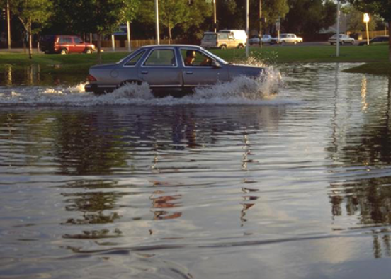
Vehicle Submersion
Two feet of water can carry away most vehicles

Slide 146
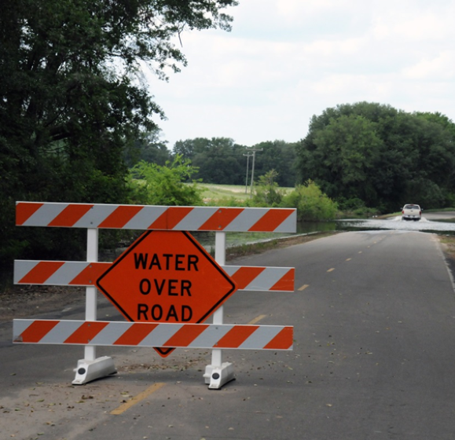
Avoiding Vehicle Submersion
Avoid travel during hurricanes and major storms
Never drive across a flooded roadway
Adhere to road and traffic barricades

Slide 147
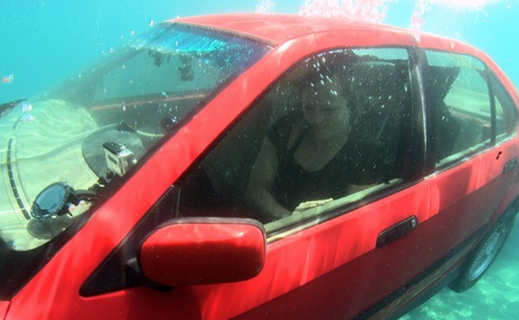
Surviving Vehicle Submersion
Keep calm and assess the situation

Slide 148
Stopping and Following Distance

Slide 149
Which of these statements is true?
When following another passenger vehicle…
Car length is an acceptable distance
The Two-Second Rule is an acceptable distance
The Three-Second Rule is an acceptable distance

Slide 150
Following Distance
NSC recommends at least a three-second minimum following distance under ideal driving conditions for passenger vehicle drivers.

Slide 151
Why Not Two Seconds?

Slide 152
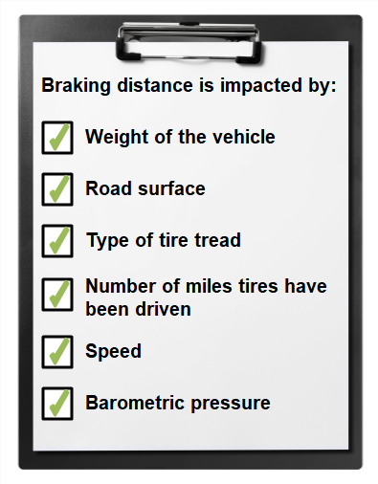
The Three-Second Rule

Slide 153
Distracted Drivers

Slide 154
Stopping Distance
Perception Distance
Reaction Distance
Braking Distance
+
+

Slide 155
Perception Distance
The distance a vehicle travels from the moment the event occurs – such as the brake lights ahead come on – until the driver sees it and becomes aware of the danger.

Slide 156
Reaction Distance
The distance a vehicle travels while the driver is moving his or her foot from the accelerator to the brake.

Slide 157
Braking Distance
The distance a vehicle travels from the time the brake is applied until the vehicle stops. This varies depending on the vehicle and braking system.

Slide 158
Stopping Distances

Slide 159
Which of these statements is true?
When you are driving a large commercial vehicle, how many seconds should you allow for following distance?
2 seconds
3 seconds
5 seconds
7 seconds

Slide 160
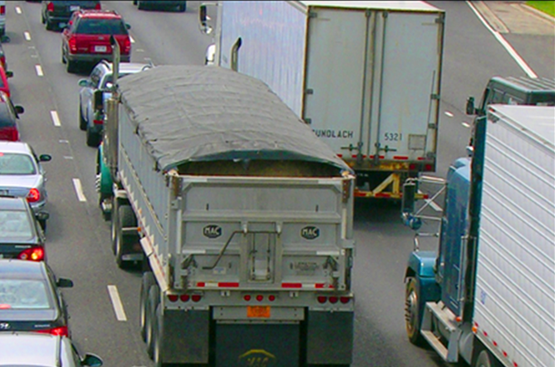
Seven-Second Rule
Crash costs are higher because these crashes usually result in bodily injury

Slide 161
The Seven-Second Plus Rule
Speeds below 40 mph: use one second for each 10 feet of vehicle length
Speeds above 40 mph: use one second for each 10 feet of vehicle length AND add one more second
Special loads: add the overhang to the vehicle length
Poor driving conditions: add one second for each condition.
Every two hours: add one second for every two hours of driving time
Being tailgated: add the tailgater’s following distance to the truck’s following distance

Slide 162
Stopping Distances

Slide 163
Braking and Stopping Distances for Large Commercial Vehicles

Slide 164
Distracted Driving

Slide 165
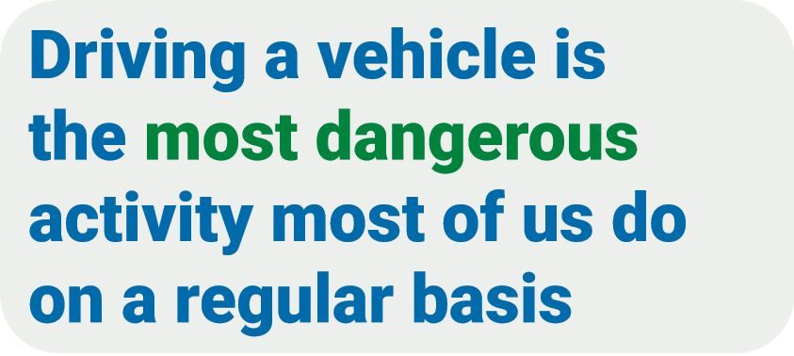

Slide 166
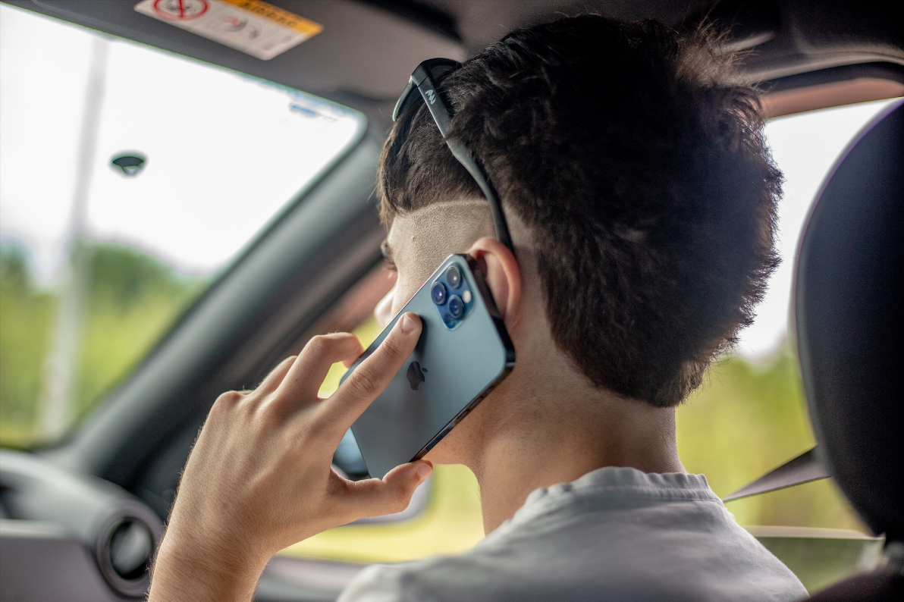
Devastating Consequences
One of the leading causes of collisions is driver distraction.

Slide 167
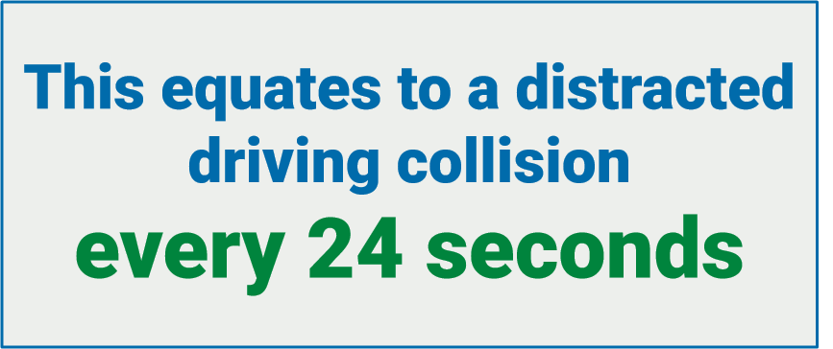

Slide 168
Distracted driving causes 400,000 injuries and 3,000 deaths every year

Slide 169
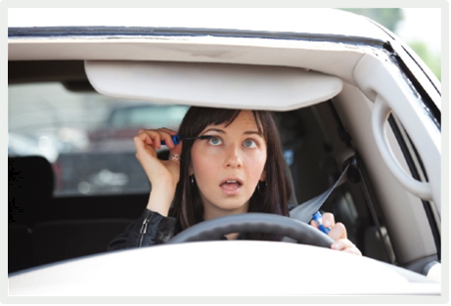
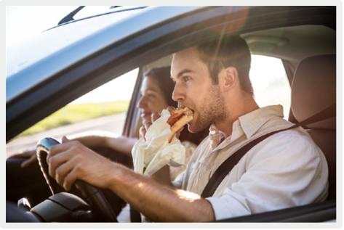
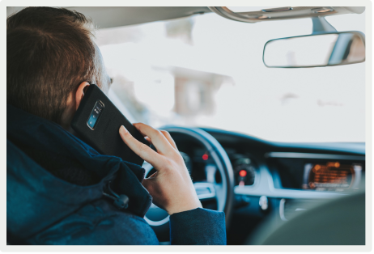
Four Types of Distraction
VISUAL: Eyes off the road
MANUAL: Hands off the wheel
AUDITORY: Unable to hear signs of trouble
COGNITIVE: Mind off driving
Use of cell phones leads
to all four types of distraction!

Slide 170
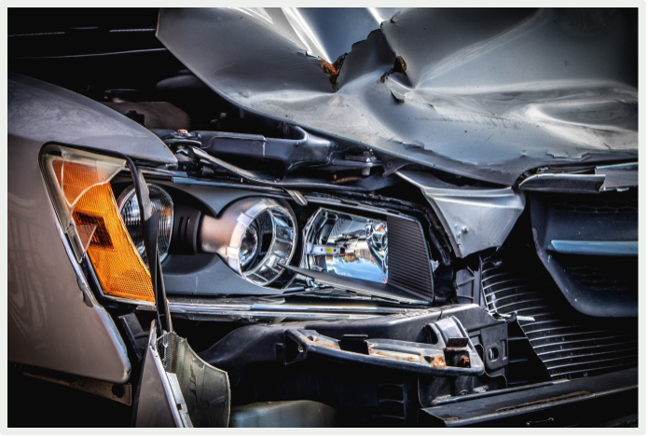
Risk and Frequency
Our crash risk associated with distracted driving depends on two factors:
Attention demands (visual, manual, auditory, and cognitive) of the distracting task
Frequency of the task

Slide 171
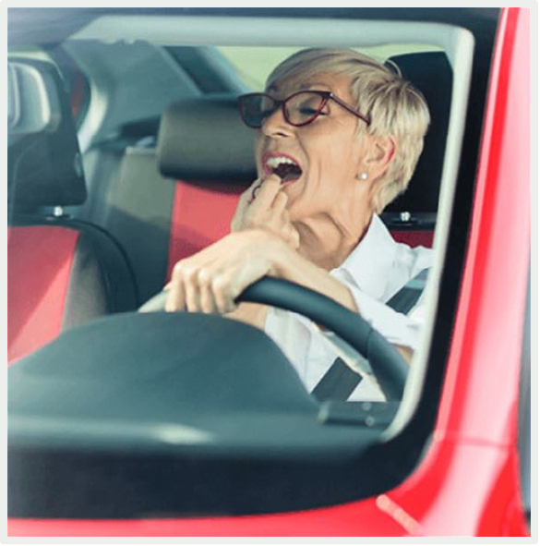
Risk and Frequency
Drivers generally know when they are visually or manually distracted
Drivers may or may not realize when they are distracted auditorily
Drivers often do not realize when they experience cognitive distractions
We are less aware of auditory and cognitive distractions. As a result, these distractions last longer.

Slide 172
Question
Which distraction do you think causes more crashes?
Talking on a cell phone
Texting on a cell phone

Slide 173
Is Using Hands-free Technology OK?
All studies show:
Hands-free devices offer no safety benefit when driving
Hands-free devices do not eliminate auditory or cognitive distractions

Slide 174
Cell Phones Are a Problem!
In 2019, 41% of daytime drives in the U.S. featured phone distraction
Phone distraction occurred in 52% of trips that resulted in a crash
The average distraction was 135 seconds
Phone distraction lasts for two minutes or more on 20% of drives with distraction … and often occurs at high speeds: 29% at speeds exceeding 56 miles per hour.

Slide 175
The Distraction Hangover
Drivers experience cognitive distraction for an average of 23 seconds post-call.
During this time, the driver is unaware of the road around them despite no longer interacting with their phone.
This is referred to as the “Distraction Hangover.”

Slide 176
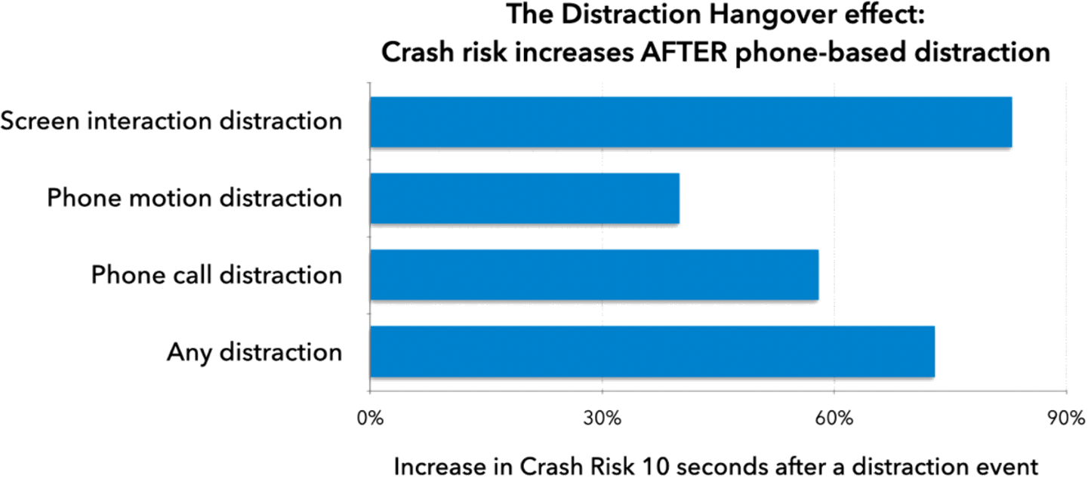
The Distraction Hangover
The hangover period and severity varies depending on the type of distraction.

Slide 177
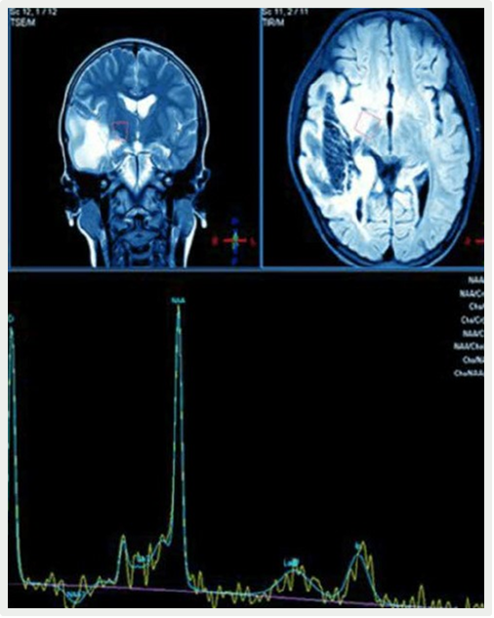
The Brain Controls Driving
Participants drove a simulator while inside an MRI scanner.
Participants listened to spoken sentences and decided if the sentences were true or false.
State-of-the-art functional magnetic resonance imaging (MRI) measurements were made.

Slide 178
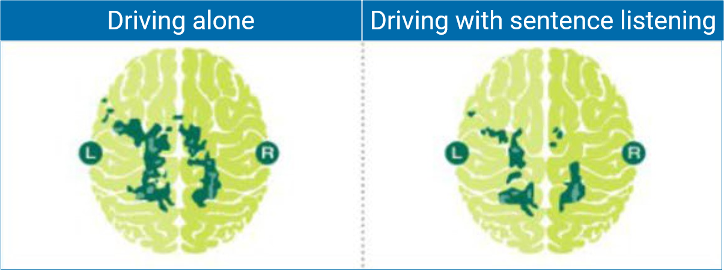
The Brain Controls Driving
The risks are measurable

Slide 179
Cell Phone Use vs. Under the Influence
4 times more likely to be involved in a crash if you’re talking on a cell phone.
4 times more likely to be involved in a crash if you are driving with a .08 BAC

Slide 180
Texting While Driving
Texting while driving isn’t just a teenage problem
47% of adults admit they text while driving

Slide 181
Texting While Driving
NHTSA reports that the average text takes the driver’s eyes off the road for
4.6 seconds

Slide 182
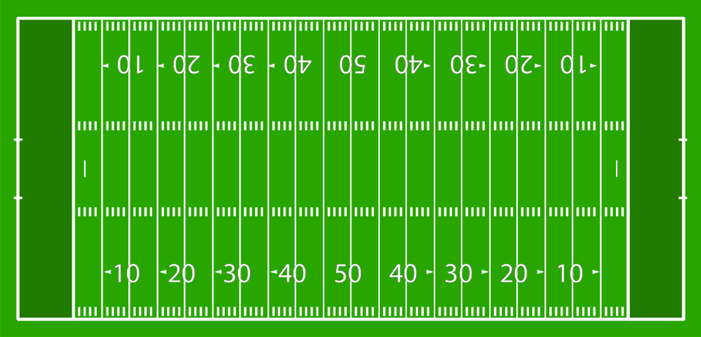
Texting While Driving
When driving 55 miles per hour, 4.6 seconds is enough time to travel 120 yards - the length of a football field, including the end zones – while blindfolded.

Slide 183
Texting While Driving
The sound of an incoming message elicits a physiological reaction.
The chemical dopamine is released, activating the pleasure center of the brain.
Source: University of Kansas study

Slide 184
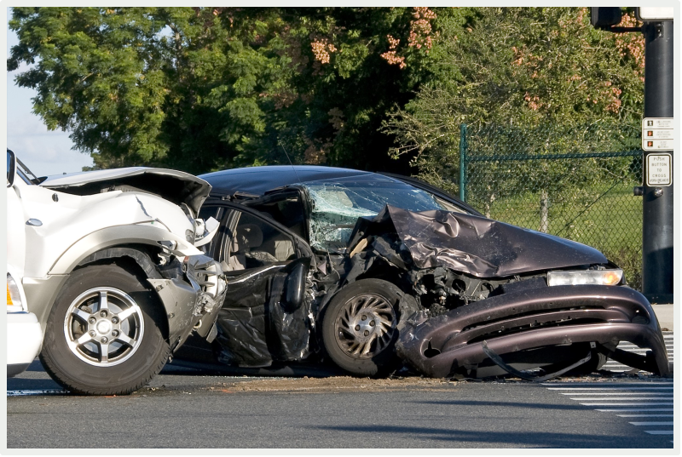
Texting While Driving
The risks outweigh the reward
Texting drivers are up to 23 times more likely to be involved in a crash than non-texting drivers.
Source: Virginia Tech Transportation Institute

Slide 185
Key Points
Distracted driving is any activity that diverts the driver’s attention from driving and responding to the changing environment
Four types of distraction: visual, manual, auditory, cognitive
We are less aware of auditory and cognitive distractions
Hands-free devices offer no safety benefit
Talking on a cell phone while driving is comparable to a .08 BAC
Texting drivers are up to 23 times more likely to be involved in a crash

Slide 186
Can You Multitask?
Test your brain!
Say your ABCs out loud
Count from 1-26 out lout
Now alternate them: A-1, B-2, C-3, etc.

Slide 187
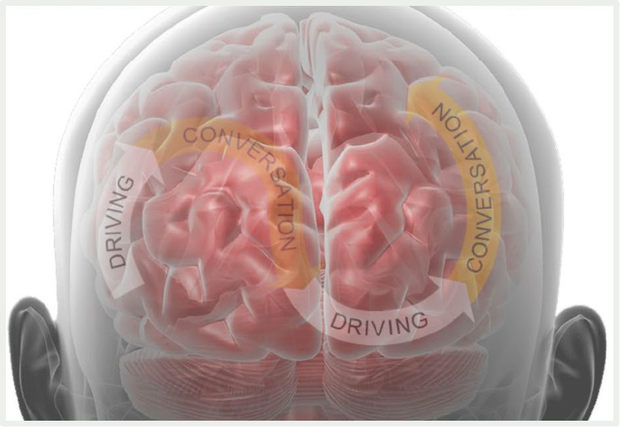
Can the Brain Multitask?
The human brain cannot perform two complex tasks at once.
Instead, the brain handles tasks sequentially, switching focus and attention from one task to another.
This can happen very rapidly, leading us to erroneously think we are doing two tasks at the same time.

Slide 188
Can the Brain Multitask?
“To put it bluntly, research shows we can’t multitask. We are biologically incapable of processing attention-rich inputs simultaneously.”
John Medina, molecular scientist and author of Brain Rules.

Slide 189
Multitasking and Productivity
Attempting to do two thinking tasks at the same time can reduce productivity by ~40 percent.

Slide 190
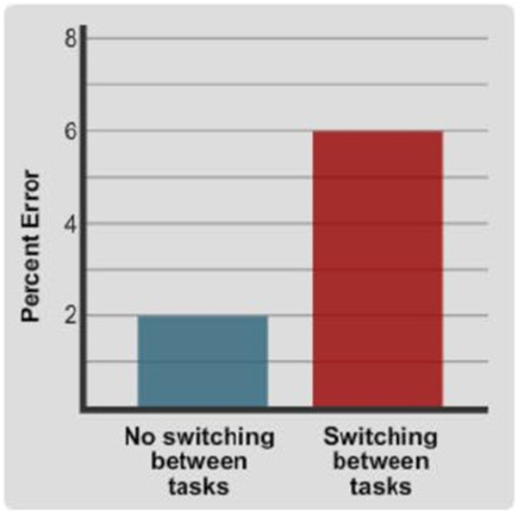
Multitasking and Productivity
Studies show that a person makes 3 times more errors when switching between tasks.

Slide 191
Common Driver Errors
Drivers make two common errors when they are cognitively distracted:
Inattention blindness
Slower response and reaction time

Slide 192
Inattention Blindness
Drivers engaged in cell phone conversations have a tendency to “look at,” but not “see” objects. This is referred to as inattention blindness.

Slide 193
Inattention Blindness
Distracted drivers fail to see ~50 percent of the information in the environment around them!

Slide 194
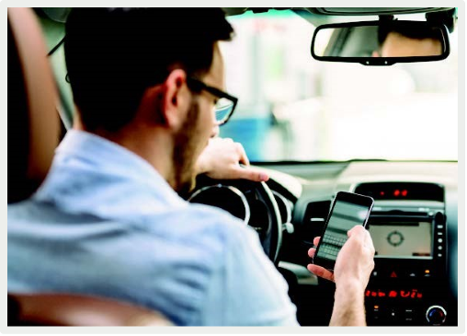
Slower Response and Reaction Time
Time switching attention from one task to another adds up and can have serious consequences.
If you are in a driving situation where you must react quickly, even small increments of time can prove critical.

Slide 195
Driver Confidence and Self-Awareness
Most drivers believe they are personally capable of driving safely while using their mobile device … even though they believe other drivers cannot drive safely while using a mobile device.
This is a misconception!

Slide 196
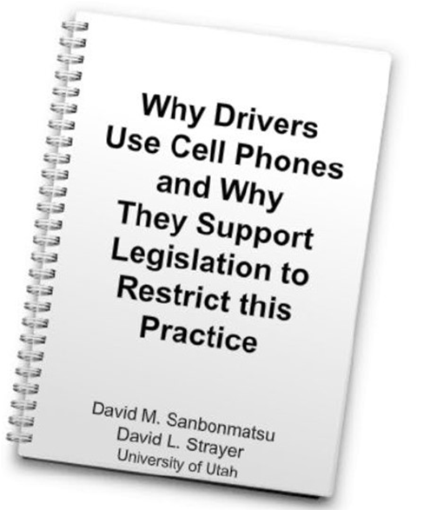
Driver Confidence and Self-Awareness
In a recent study, participants drove a simulator while talking or not talking on the phone.
Drivers talking on the phone made more errors.

Slide 197
Driver Confidence and Self-Awareness
Participants completed self-assessments:
“No cell phone” self-assessments correlated with actual errors
“Cell phone” self-assessments did NOT correlate with actual errors

Slide 198
Driver Confidence and Self-Awareness

Slide 199
Societal Impact

Slide 200
Societal Impact
$120 million
every single day of the year!
Plus, the indirect costs more than triple the financial impact on us as a society

Slide 201
Employer Impact

Slide 202
Employer Impact
Beyond the safety issues and direct costs associated with an employee crash, employers and employees are now being held legally responsible.

Slide 203
Employer Impact
If an employee is involved in a conversation while driving, their attention to a customer on the phone is less than 50%.

Slide 204
Personal Impact
There is no greater loss than the loss of a loved one, especially when it was completely preventable.

Slide 205
Personal Impact
Property damage
Increased insurance rates
Lost wages
Legal fees

Slide 206
The Problem Is Growing

Slide 207
In-Car Technologies

Slide 208
In-Car Technologies

Slide 209
Addressing Distracted Driving

Slide 210
Distracted Driving Laws
Distracted driving laws currently address three categories of usage:
Text Messaging
Handheld Cell Phones
All Cell Phone Use

Slide 211
Distracted Driving Laws
Primary law: an officer can ticket a driver for an offense without another traffic violation in place.
Secondary law: an officer can only issue a ticket if a driver has been pulled over for another violation.
New York State has a PRIMARY distracted driving law.
New York is currently the ONLY state that uses “Text Stops” on their interstate system and toll road (Thruway).

Slide 212
Distracted Driving Laws
Many states prohibit all drivers from using handheld cell phones while driving.

Slide 213
Distracted Driving Laws
Currently, no states ban all cell phone use for all drivers.
The majority of states ban all cell phone use by novice drivers.
Many states ban all cell phone use by bus drivers.

Slide 214
New York State Fines and Penalties
Fines and Violation Points for Cell Phone Use and Texting
Violation | Min. Fine | Max. Fine | Violation Points
First Offense | $50 | $200 | 5 points
Second offense w/in 18 months | $50 | $250 | 5 points
Third offense w/in 18 months | $50 | $450 | 5 points

Slide 215
Distracted Driving Laws
Best practice would be to not allow any use of phones or other mobile devices while driving.
Text Messaging
Handheld Cell Phones
All Cell Phone Use

Slide 216
Distracted Driving Laws
Don’t wait for laws to change to change your behavior.
Following the law isn’t enough!

Slide 217
Distracted Driving Is a Choice
YOU have the power to take an important step to greatly reduce your personal risk and the risk to your family and passengers.

Slide 218
Distracted Driving Is a Choice

Slide 219
What Can You Do?
Before you drive:
Make a commitment
Change your voice mail greeting
Inform clients, associates and frequent callers
If you are unfamiliar with your route, prepare before you drive
Turn off your cell phone or put it on vibrate or in silent mode

Slide 220
What Can You Do?
While you drive:
Do not make or answer calls or texts, even with hands-free devices.
If you are driving with a passenger, allow them to operate your phone if necessary.
If it is imperative that you be connected during a long trip, arrange for someone else to drive.
Focus on the road.

Slide 221
Distracted Driving
Working together, we can make a difference, save lives and prevent injuries.

Slide 222
Instructor Open Forum
What techniques have you used to manage your class and deal with disruptive behavior?
How can the “Lazy Eight” technique or Five Questions help you overcome objections?
How do you discuss distracted driving concepts with participants?
How can you help participants choose safe and effective driving behaviors?

Slide 223
New York State Classroom Administration Point & Insurance Reduction Program (PIRP)

Slide 224
Greetings from Your DMC Team!

Slide 225
Syracuse DMC Contact Information
Call: 800-962-3434
Email: ddcny@nsc.org (this mailbox is monitored by the team)

Slide 226
Classroom Requirements
The following must be posted in the classroom at all times during the course:
“National Safety Council” and NSC Telephone Number (1-800-962-3434)
Delivery Agency Name and Telephone Number
Your Full Name and NSC Instructor ID Number

Slide 227
Classroom Requirements
Instructors are to maintain order in the classroom.
If necessary, ask student to leave the classroom if they are being disruptive
Make sure that class size does not exceed DMV requirements of 40 students maximum:
Delivery Agency should calculate student capacity using the following guidelines: Multiply room width times the length, then divide by 15. (Example: 20’ x 20’ room = 400/15, which could accommodate 26 students).

Slide 228
Classroom Requirements
Class must be taught for the full scheduled time.
If a student arrives late to class give them options:
Allow student to make up the time (within reason)
If it’s a two-day class, they can complete one session and sign up for the 2nd session they missed within 30 days

Slide 229
Classroom Supplies
Each participant must receive:
Copyrighted NSC Course Guide (cannot be reused or copied)
PIRP Facts for Consumers (Form C-32A)
Student Record Card
DMV Manual (to reference)

Slide 230
Classroom Supplies
Student Record Cards:
Must be filled out in entirety. Driver’s License #, Date of Birth, Gender and Name MUST be exactly as shown on the student’s Driver’s License
Delivery Agency must keep one copy for their records
Delivery Agency must give one copy to the student as their receipt for the class taken

Slide 231
Class Sign-in Form

Slide 232
Class Report Form
Class code should be the same as on the Student Record Cards and Sign-In Sheet
Needs to be filled out in its entirety
Instructor Name
Instructor Number
Number of Students Trained
Total due for class

Slide 233
Certificate of Completion
Mailed from NSC within 45 business days after class completion
Inform students to contact NSC if they do not receive their certificate after 45 business days
$10 fee for duplicate certificates requested after 6 months of course completion and for requests to have certificates emailed or mailed to a different address than the one on file

Slide 234
Q&A
What tips do you as the instructors have to share?
Is there anything from the 10th edition that you found needed more explanation?
What would you add to the 11th edition?

Slide 235
The National Safety Council thanks you for your continued support in our mission to educate drivers to help make safer roads

